Slide 1
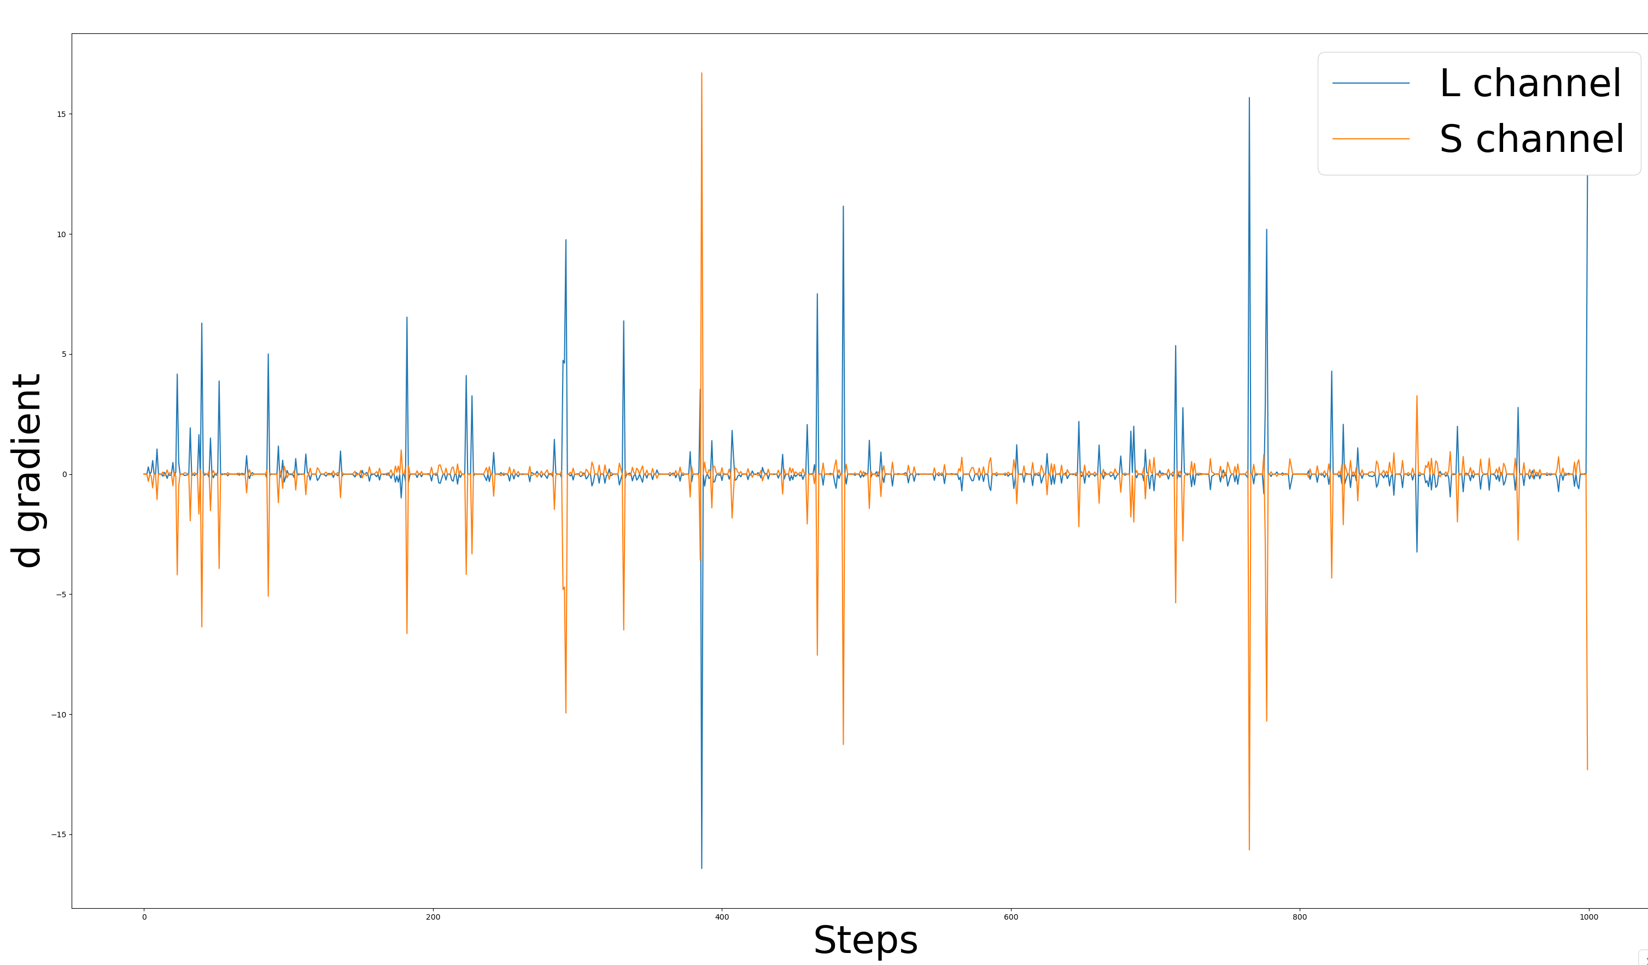
Gradients for the d parameter in L and S channels are always opposite in sign for a single neuron (this is true for all the neurons I’ve tested)

Slide 2
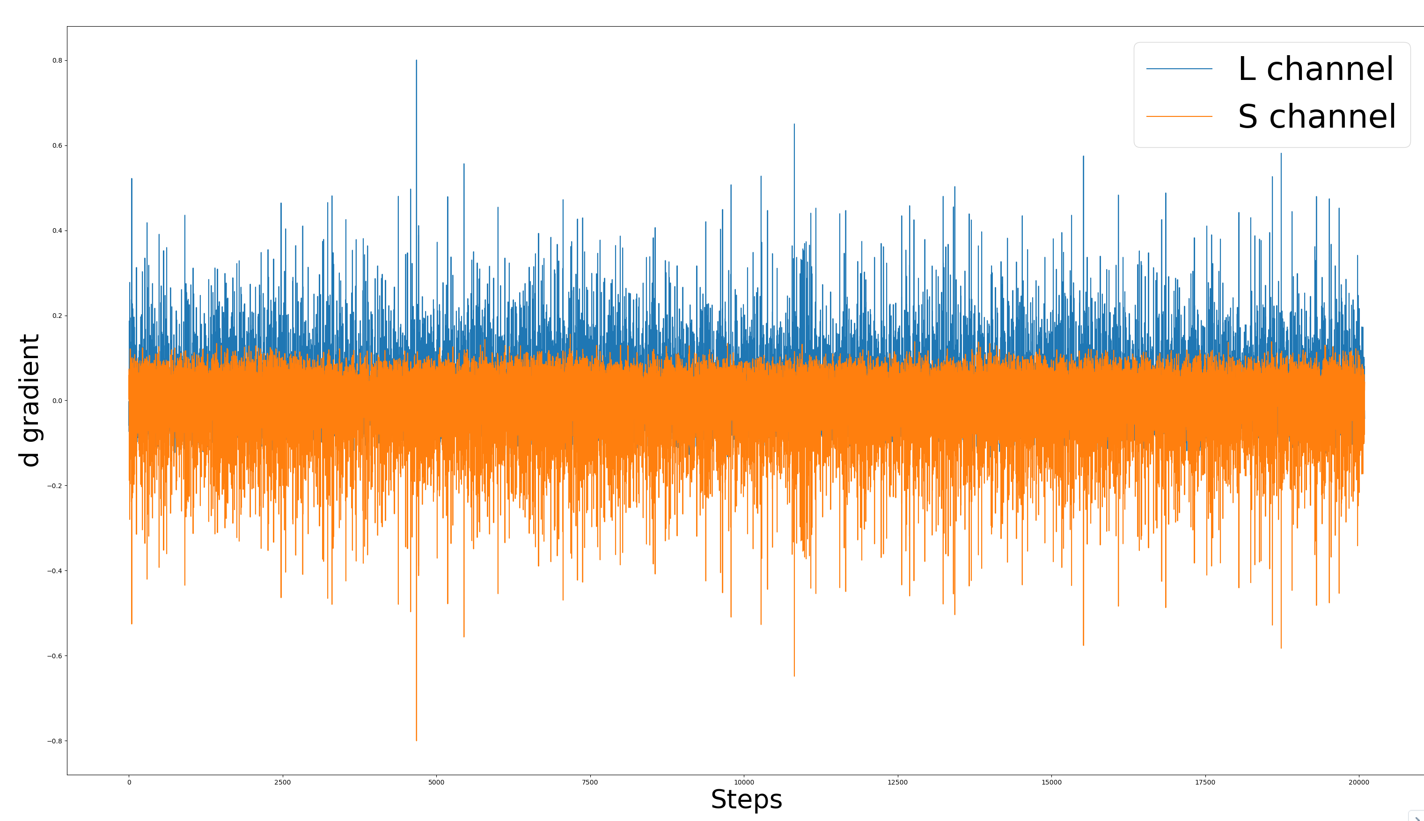
Positive and negative gradients for each channel do not cancel out (this is not true for all neurons)

Slide 3
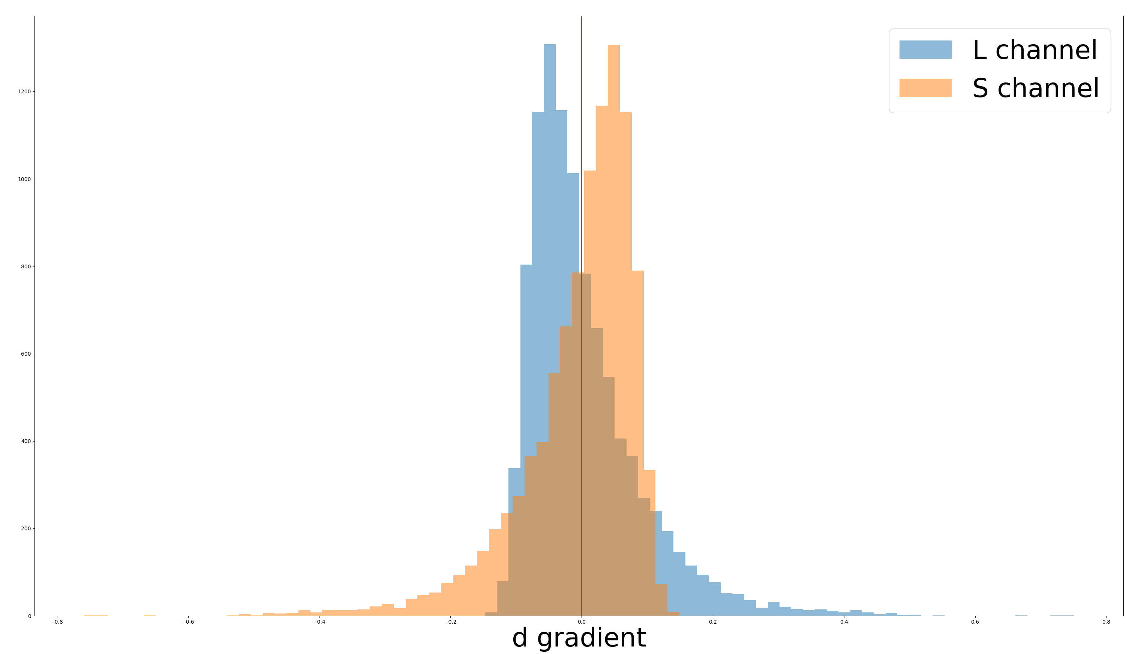
Ps: The mean of each distribution is half a standard deviation away from 0

Slide 4
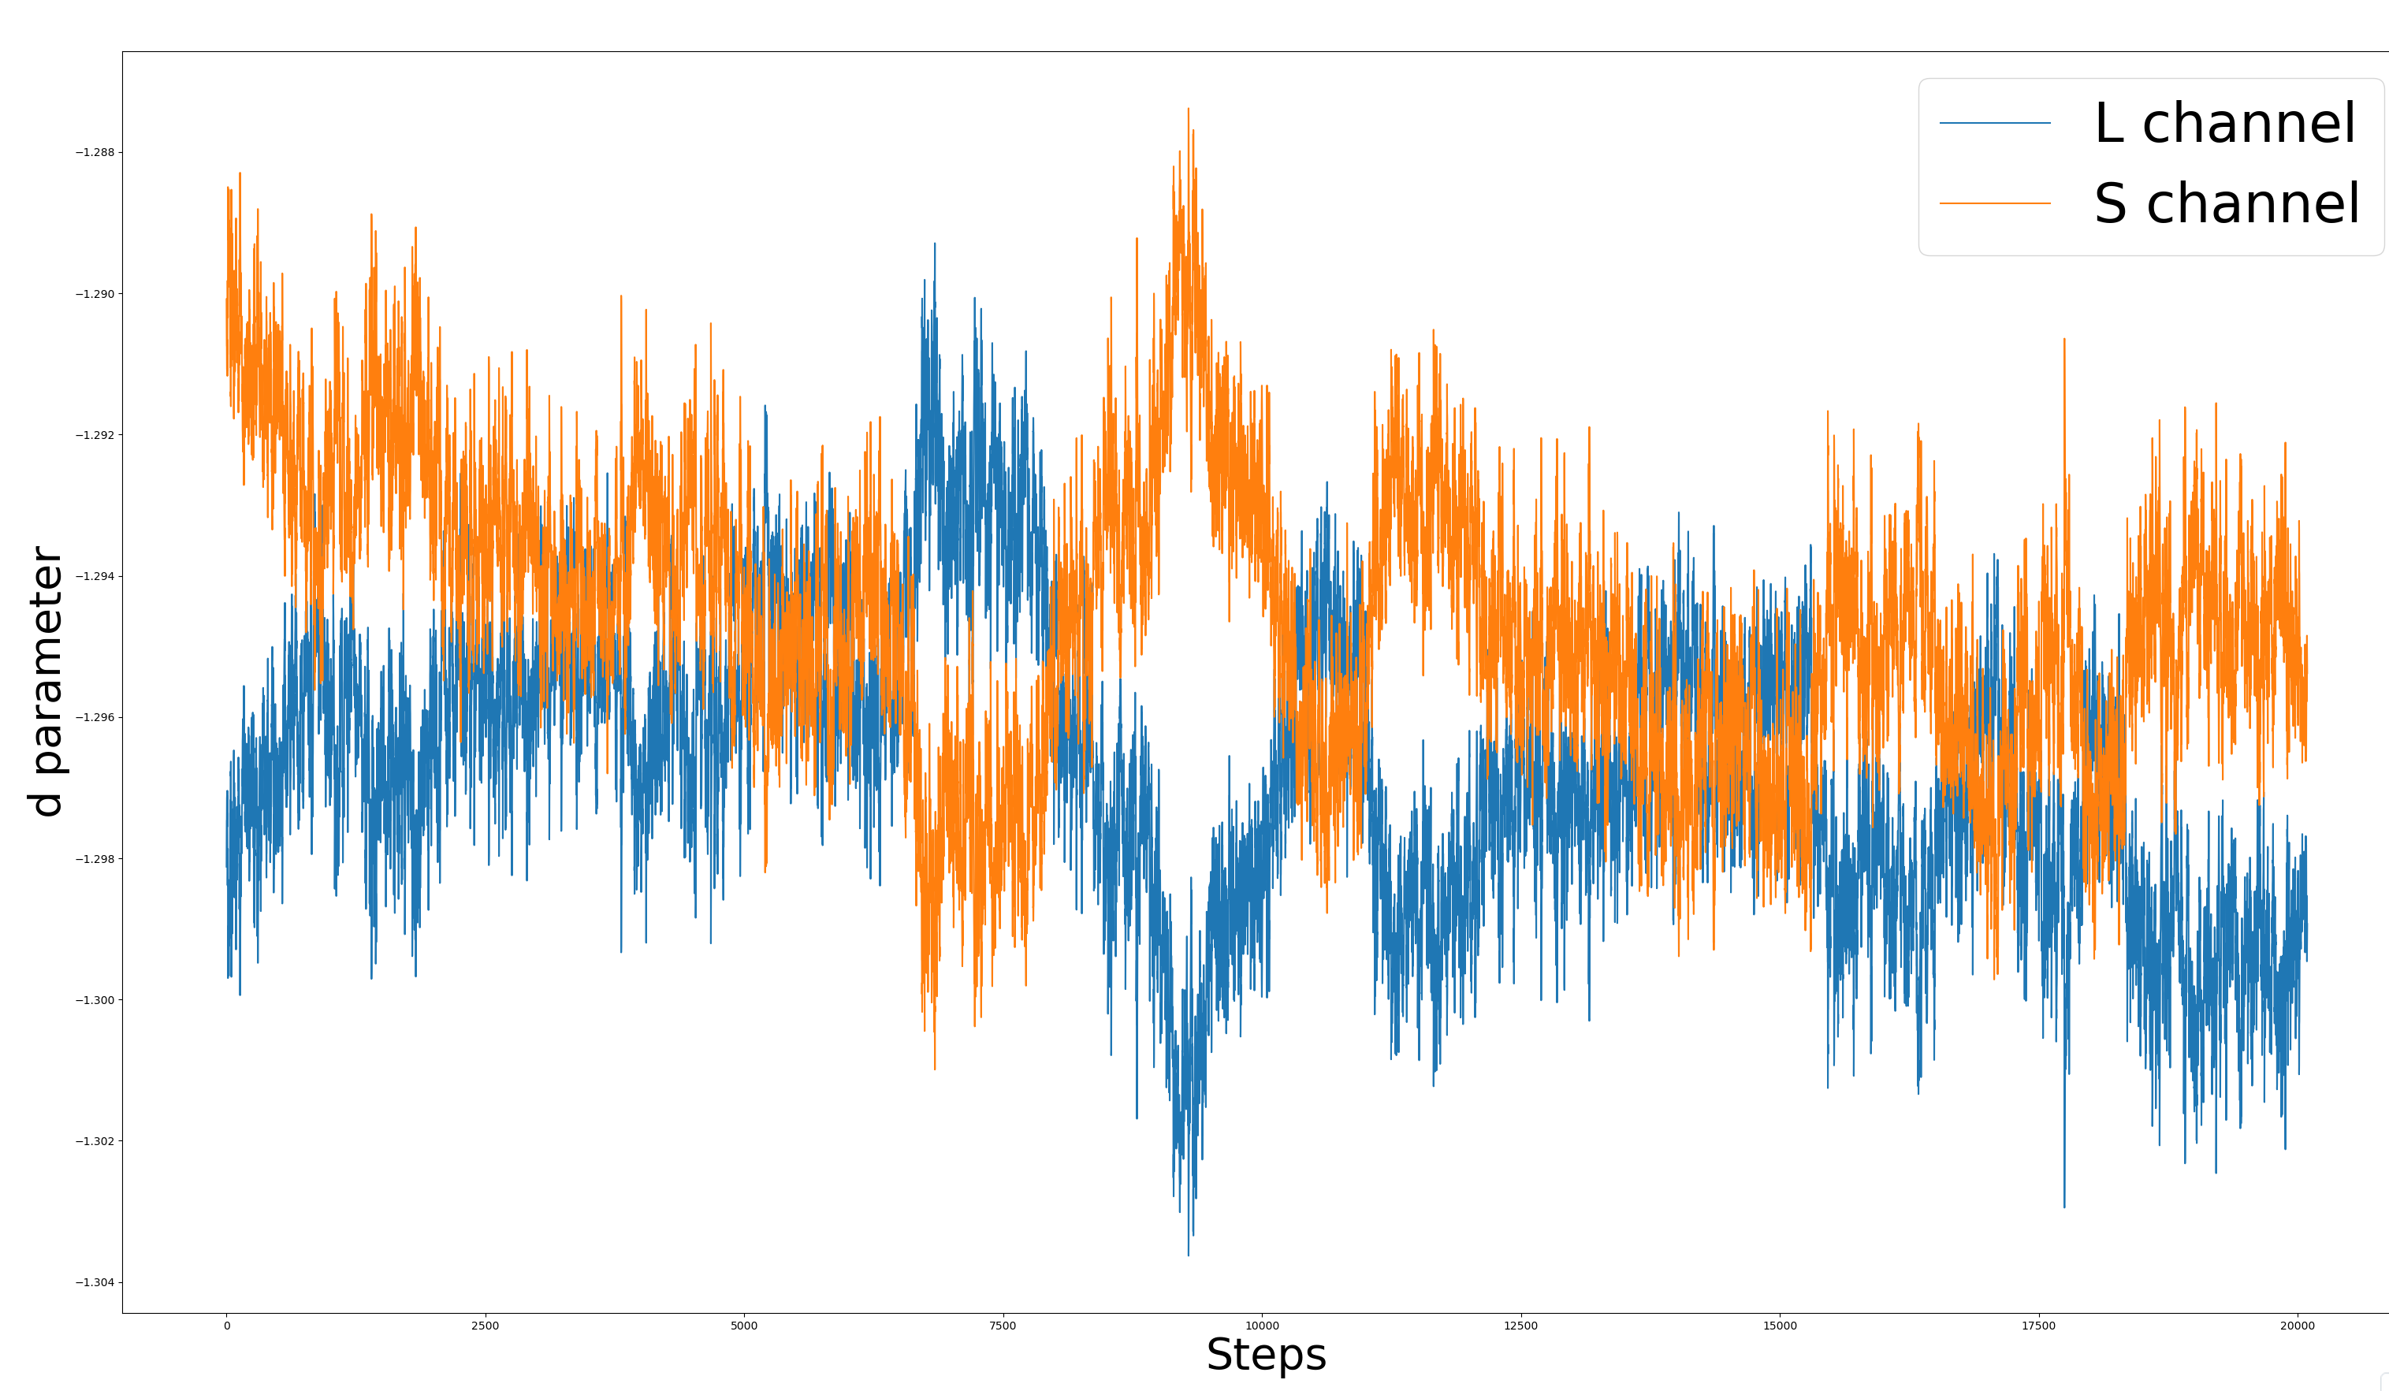
d parameter does not change much across steps

Slide 5
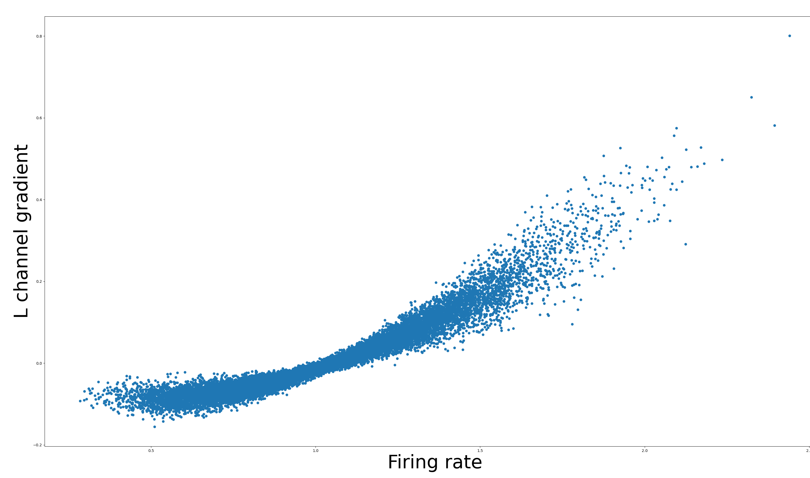

Slide 6
W normalization
The weights are getting normalized 3 times per step
1 normalization uses torch.no_grad(), the other 2 do not.

